Slide 1
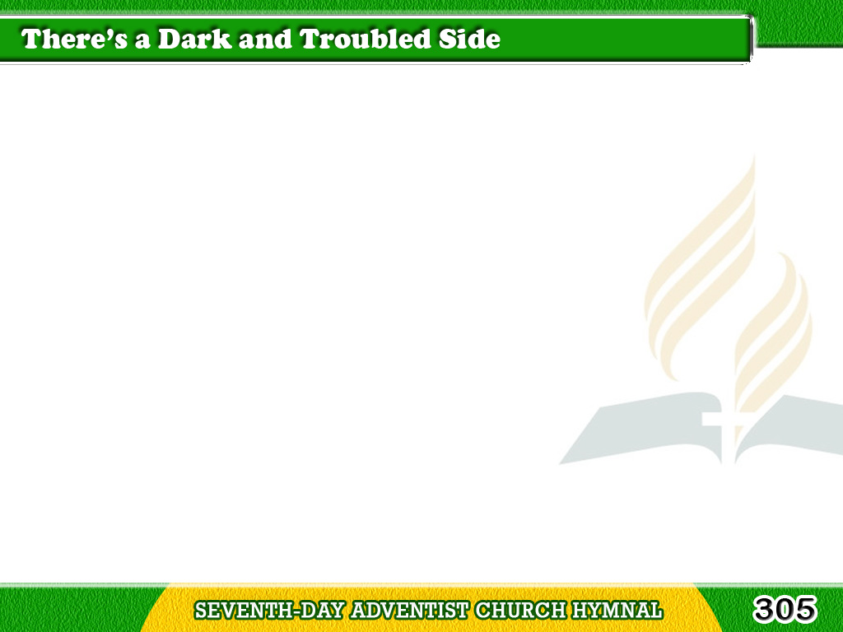
1/3
There’s a dark
and a troubled side of life;
There’s a bright
and sunny side, too;
Tagalog
Version

Slide 2
1/3
Tho’ we meet
with the darkness and strife,
The sunny side
we also may view.
Tagalog
Version

Slide 3
1/3
Chorus
Keep on the sunny side,
Always on the sunny side,
Keep on the sunny side of life,
Tagalog
Version

Slide 4
1/3
Chorus
It will help us every day,
It will brighten all the way,
If we keep on
the sunny side of life.
Tagalog
Version

Slide 5
2/3
Tho’ the storm
in its fury breaks today;
Crushing hopes
that we cherished so dear;
Tagalog
Version

Slide 6
2/3
Storm and cloud
will in me pass away,
The sun again
will shine bright and clear.
Tagalog
Version

Slide 7
2/3
Chorus
Keep on the sunny side,
Always on the sunny side,
Keep on the sunny side of life,
Tagalog
Version

Slide 8
2/3
Chorus
It will help us every day,
It will brighten all the way,
If we keep on
the sunny side of life.
Tagalog
Version

Slide 9
3/3
Let us greet with a song
of hope each day,
Tho’ the moments
be cloudy or fair;
Tagalog
Version

Slide 10
3/3
Let us trust
in our Savior always
Who keepeth every one
in His care.
Tagalog
Version

Slide 11
3/3
Chorus
Keep on the sunny side,
Always on the sunny side,
Keep on the sunny side of life,
Tagalog
Version

Slide 12
3/3
Chorus
It will help us every day,
It will brighten all the way,
If we keep on
the sunny side of life.
Tagalog
Version

